Slide 1
Unit 3: Adding Code to a Microsoft ASP.NET Web Form

Slide 2
Overview
Using Code-Behind Pages
Adding Event Procedures to Web Server Controls
Using Page Events

Slide 3
Lesson: Using Code-Behind Pages
How to Implement Code
Writing Inline Code
What are Code-Behind Pages?
Understanding How Code-Behind Pages Work

Slide 4
How to Implement Code
Three methods for adding code:
Put code in the same file as content (mixed)
Put code in a separate section of the content file (inline code)
Put code in a separate file (code-behind pages)
Code-behind pages are the Visual Studio .NET default

Slide 5
Writing Inline Code
Code and content in the same file
Different sections in the file for code and HTML
<HTML>
<asp:Button id="btn" runat="server"/>
</HTML>
<SCRIPT Language="vb" runat="server">
Sub btn_Click(s As Object, e As EventArgs) Handles btn.Click
...
End Sub
</SCRIPT>
<HTML>
<asp:Button id="btn" runat="server"/>
</HTML>
<SCRIPT Language="c#" runat="server">
private void btn_Click(object sender, System.EventArgs e)
{
. . .
}
</SCRIPT>

Slide 6
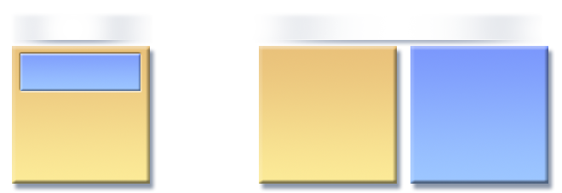
What are Code-Behind Pages?
Separation of code from content
Developers and UI designers can work independently
Single file
Separate files
code
<tags>
code
<tags>
Form1.aspx
Form1.aspx
Form1.aspx.vb
or Form1.aspx.cs

Slide 7
Understanding How Code-Behind Pages Work
Create separate files for user interface and interface logic
Use @ Page directive to link the two files
Pre-compile or JIT-compile
Page1.aspx
<% @ Page Language="c#" Inherits="Project.WebForm1" Codebehind="Page1.aspx.cs" Src = "Page1.aspx.cs" %>
Page1.aspx.cs
public class WebForm1 {
private void cmd1_Click()
{ …
}
}

Slide 8
Lesson: Adding Event Procedures to Web Server Controls
What are Event Procedures?
Demonstration: Using Events
Client-Side Event Procedures
Server-Side Event Procedures
Multimedia: Client-Side and Server-Side Events
Creating Event Procedures
Instructor-Led Practice: Creating an Event Procedure
Interacting with Controls in Event Procedures

Slide 9
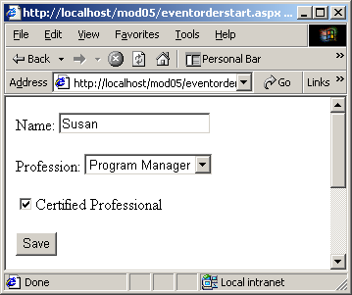
What are Event Procedures?
Action in response to a user’s interaction with the controls on the page

Slide 10

Demonstration: Using Events
Open an ASP.NET page with controls and client-side and server-side event procedures
Click on the controls to view client-side and server-side events running
In the browser, view the source of the page
In the editor, view the event procedure code

Slide 11
Client-Side Event Procedures
Typically, used only with HTML controls only
Interpreted by the browser and run on the client
Does not have access to server resources
Uses <SCRIPT language="language">
.HTM Pages
Internet

Slide 12
Server-Side Event Procedures
Used with both Web and HTML server controls
Code is compiled and run on the server
Have access to server resources
Use <SCRIPT language="vb" runat="server"> or <SCRIPT language=“cs" runat="server">
.ASPX Pages
Internet

Slide 13

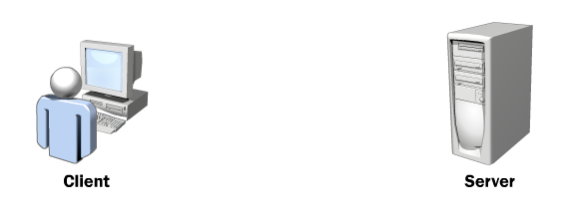
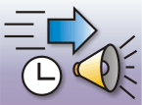
Multimedia: Client-Side and Server-Side Events

Slide 14
Creating Event Procedures
Visual Studio .NET declares variables and creates an event procedure template
Using the Handles keyword adds many event procedures to one event
Protected WithEvents cmd1 As System.Web.UI.WebControls.Button
Private Sub cmd1_Click(ByVal s As System.Object, _
ByVal e As System.EventArgs) Handles cmd1.Click
protected System.Web.UI.WebControls.Button cmd1;
private void InitializeComponent()
{
this.cmd1.Click += new System.EventHandler(this.cmd1_Click);
this.Load += new System.EventHandler(this.Page_Load);
}
private void cmd1_Click(object s, System.EventArgs e)

Slide 15
Instructor-Led Practice: Creating an Event Procedure
Create a Web Form using Visual Studio .NET
Add controls to the Web Form
Double-click one or more controls to add event procedures
Build and Browse

Slide 16
Interacting with Controls in Event Procedures
Read the properties of Web server controls
Output responses to other Web server controls
strGreeting = "Hello " & txtName.Text
strGreeting = "Hello " + txtName.Text;
lblGreeting.Text = "new text"
lblGreeting.Text = "new text";

Slide 17
Lesson: Using Page Events
Understanding the Page Event Life Cycle
Multimedia: The PostBack Process
Demonstration: Handling Events
Practice: Placing Events in Order
Handling Page.IsPostback Events
Linking Two Controls Together
Demonstration: Linking Controls Together

Slide 18
Understanding the Page Event Life Cycle
Page_Init
Page_Load
Control events
Change Events
Textbox1_Changed
Action Events
Button1_Click
Page_Unload
Page is disposed

Slide 19
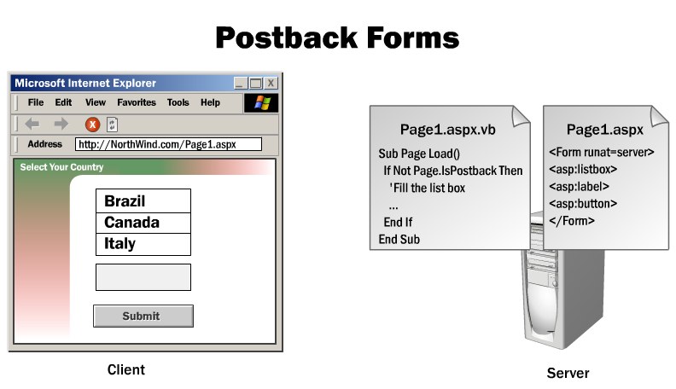
Multimedia: The Postback Process

Slide 20
Demonstration: Handling Events

Slide 21

Practice: Placing Events in Order
Students will:
Given scenarios, list the events that will happen and the order in which they will occur
Time: 5 Minutes

Slide 22
Handling Page.IsPostback Events
Page_Load fires on every request
Use Page.IsPostBack to execute conditional logic
Page.IsPostBack prevents reloading for each postback
private void Page_Load(object sender, System.EventArgs e)
{ if (!Page.IsPostBack)
{
// executes only on initial page load
}
//this code executes on every request
}
Private Sub Page_Load(ByVal s As System.Object, _
ByVal e As System.EventArgs) Handles MyBase.Load
If Not Page.IsPostBack Then
'executes only on initial page load
End If
'this code executes on every request
End Sub

Slide 23
Linking Two Controls Together
Linking one control to another is useful for taking values from list boxes or drop-down lists
Data binding
<asp:DropDownList id="lstOccupation"
autoPostBack="True" runat="server" >
You selected: <asp:Label id="lblSelectedValue"
Text="<%# lstOccupation.SelectedItem.Text %>"
runat="server" />
private void Page_Load(object sender, System.EventArgs e)
{
lblSelectedValue.DataBind();
}
Sub Page_Load(s As Object, e As EventArgs) Handles MyBase.Load
lblSelectedValue.DataBind()
End Sub

Slide 24
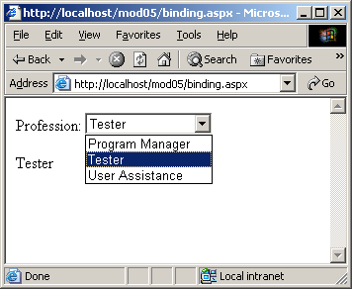
Demonstration: Linking Controls Together
Link a Label to a ListBox

